Slide 1


WIRELESS POWER TRANSFER FOR EV BATTERY CHARGING
The National Institute of Engineering
Department of Electrical and Electronics Engineering
Mananthavadi Road, Mysore-570008
Presented by
DARSHAN B K MITHUN URS P RAVI N SUNIL KUMAR S N
Under the Guidence of
MS.ASHWINI G BE,M.TECH

Slide 2
TABLE OF CONTENTS
CASE STUDY ON DYNAMIC CHARGING
COMPONENTS
METHODOLY AND SIMULATION
Li-ion BATTERY AND ITS SPECIFICATIONS

Slide 3
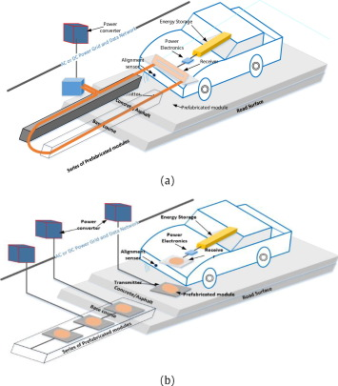
CASE STUDY ON DYNAMIC CHARGING
In order to improve the two areas of range and sufficient volume of battery storage, dynamic mode of operation of the WCS for EVs has been researched. This method allows charging of battery storage devices while the vehicle is in motion.
Need for frequent charging high capacity batteries can be reduced and the range of transportation is increased .
As shown in figures, the primary coils are embedded into the road concrete at a certain distance with high voltage, high frequency AC source and compensation circuits to the micro grid and/or RES. Secondary is onboard subsystem in EV.

Slide 4
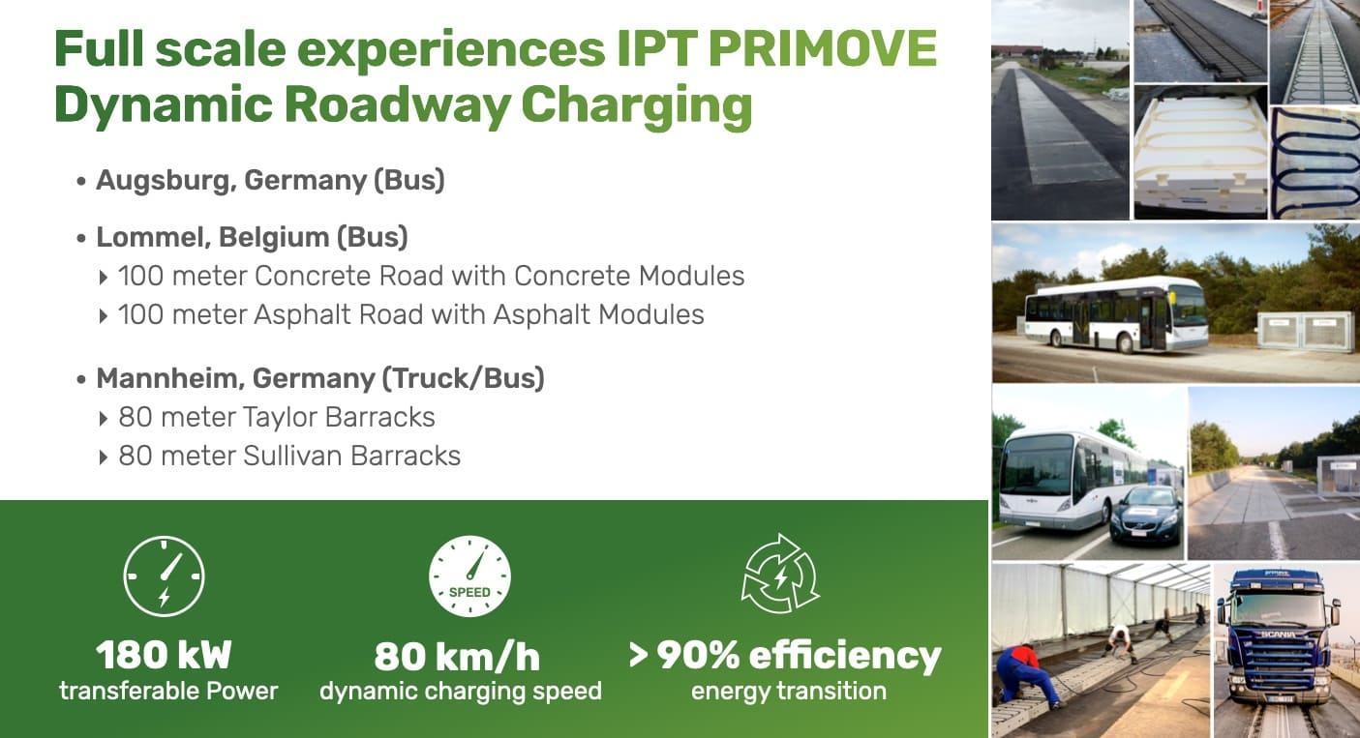

Slide 5
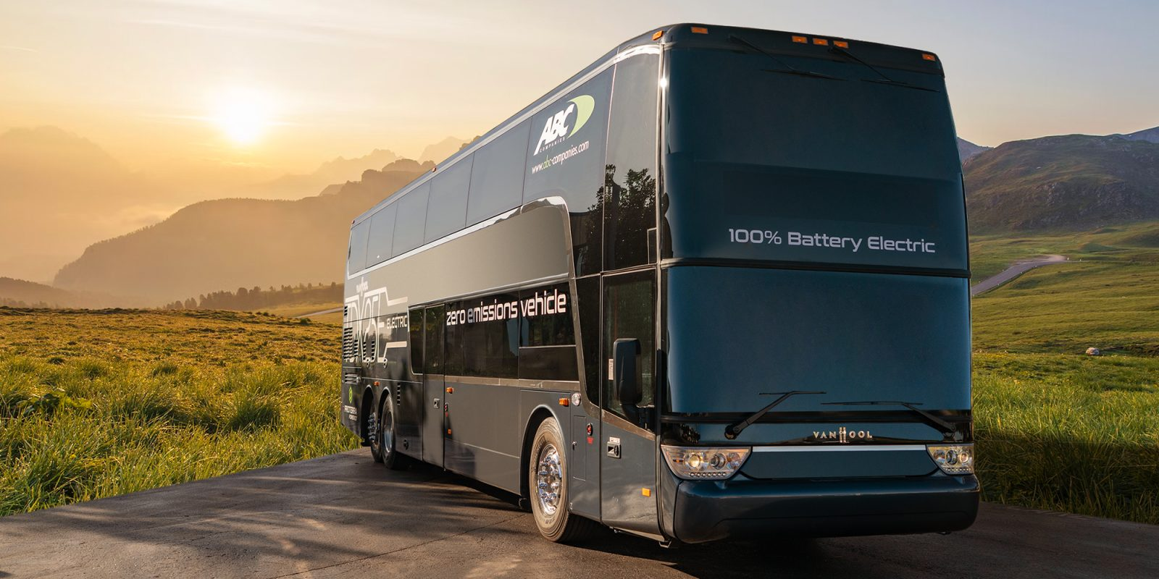
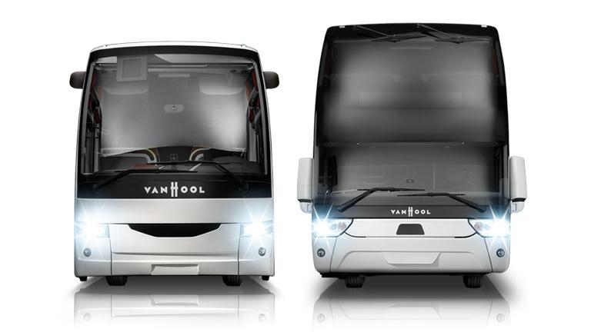
Van Hool bus
A Van Hool bus was adapted with a PRIMOVE energy pick-up system to demonstrate static and dynamic inductive charging on the road equipped with PRIMOVE technology.
The pick-up is powered by energy transfer segments of varying lengths installed in the 1.2 km road.

Slide 6

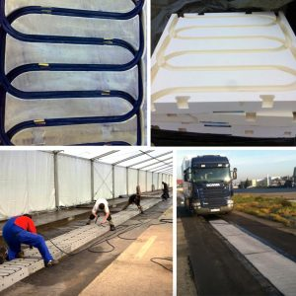
Demonstrating Dynamic charging for highway application
Vehicle: SCANIA Truck
Design constraints:
PRIMOVE 200 kW
System design based on PRIMOVE experiences
Pavement to be designed for public roads
Infrastructure according to existing design Taylor and Sullivan Barracks
The distance of the loop was calculated in order to be able to drive at 60 km/h on the PRIMOVE dynamic charging area. The whole length is approximately 330 meters. This should allow a heavy vehicle to roll at 60 km/h during 80 meters:
150 meters to achieve the speed of 80 km/h.
80 meters with Primove Dynamic charging
100 meters to break

Slide 7


Slide 8
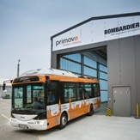
Bombardier
The electric buses from the manufacturer Solaris are fully charged overnight in the bus depot.
Recharging the batteries during a 10 minute stop at the terminus is sufficient to provide smooth operation of the 12 meter solo e-bus over the 12 km route.
The 18 meter articulated e-buses require more energy and will therefore be additionally charged for a few seconds at two intermediate bus stops.
This customised charging concept ensures maximum service life of the batteries and uninterrupted operation on the existing bus route with a clean e-mobility solution.

Slide 9
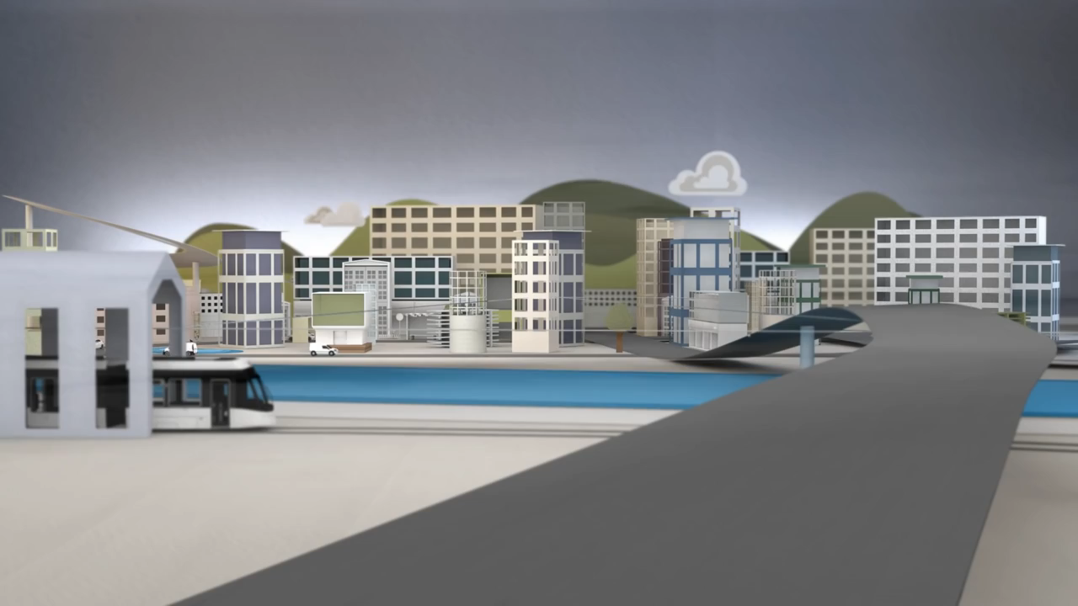

Slide 10
COMPONENTS
AC Voltage source.
Source rectifier circuit.
High frequency Inverter circuit.
Compensation network.
Mutual Inductor.
Vehicle Rectifier circuit.
Li-ion Battery.

Slide 11
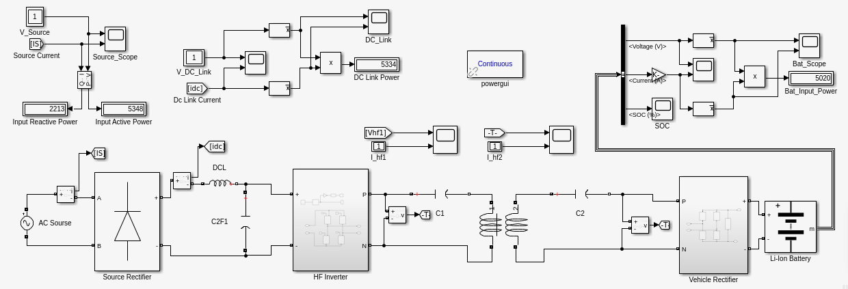
SIMULATED DIAGRAM

Slide 12
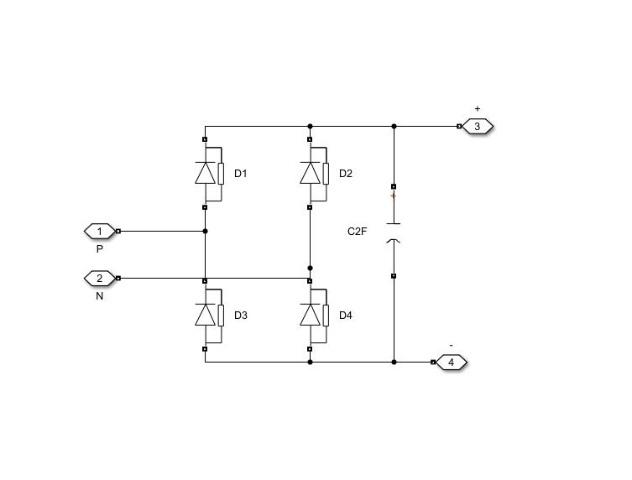
RECTIFIER CIRCUIT:

Slide 13
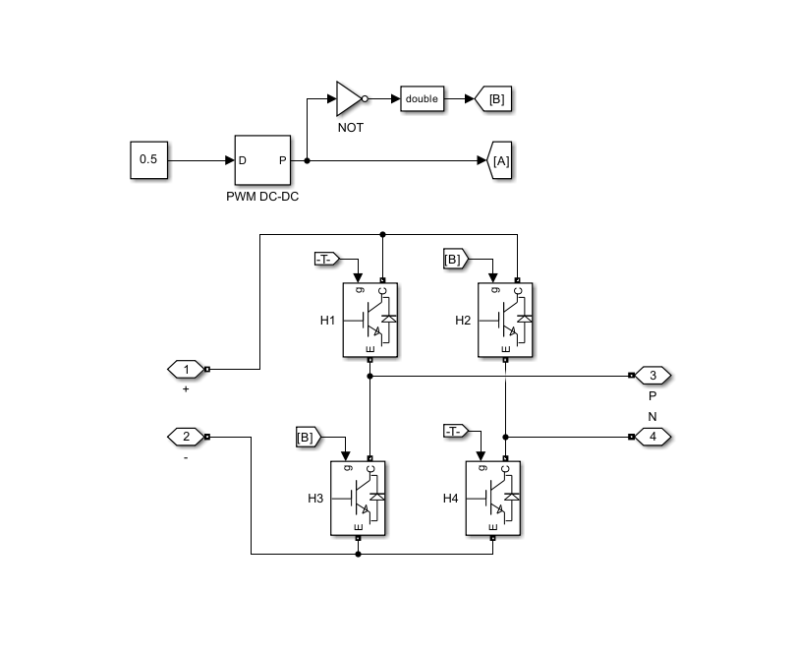
INVERTER CIRCUIT:

Slide 14
Series compensation:
Series compensation has several advantages like it increases transmission capacity
improve system stability
control voltage regulation
ensure proper load division among parallel feeders.

Slide 15
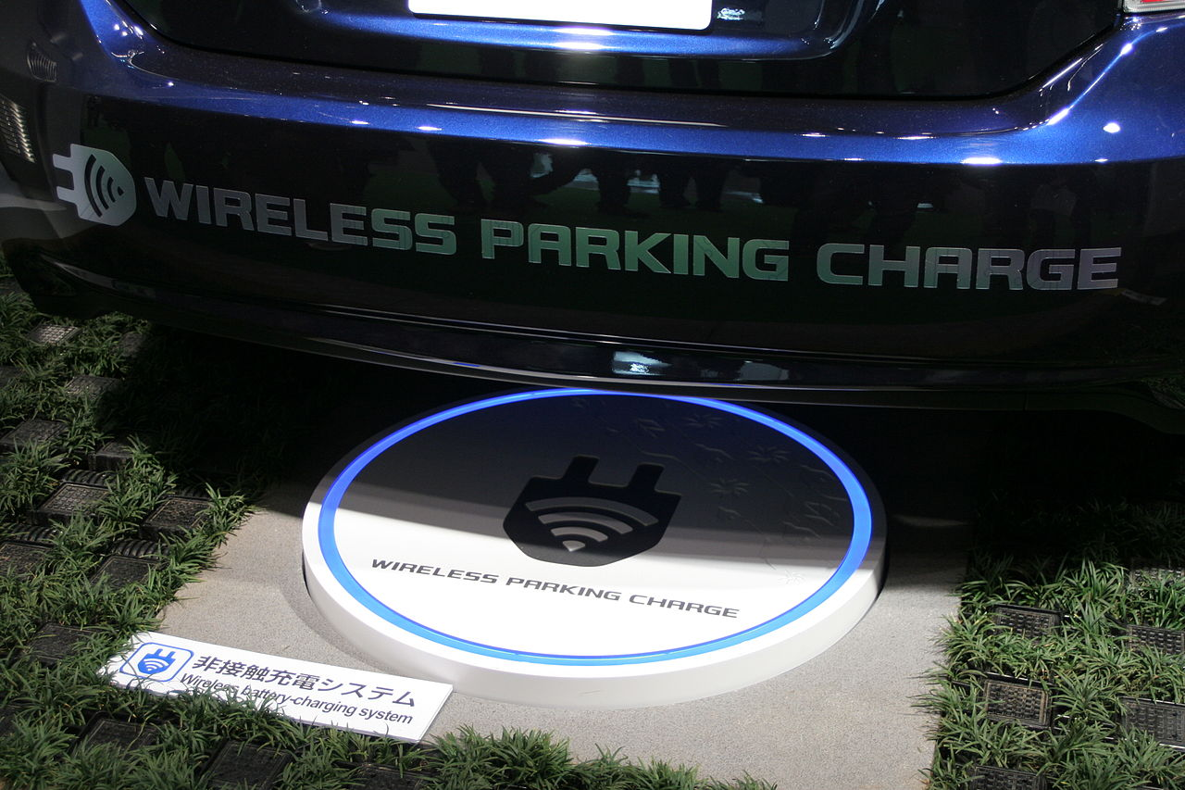
WHY INDUCTIVE CHARGING IS PREFERRED FOR WPT
Protected connections –Less risk of electrical faults such as short circuit.
Low infection risk – For embedded medical devices, the transmission of power via a magnetic field passing through the skin avoids the infection risks associated with wires penetrating the skin.
Durability –there is significantly less wear and tear on the socket of the device.
Increased convenience and aesthetic quality – No need for cables.
Automated high power inductive charging of electric vehicles allows for more frequent charging events and consequently an extension of driving range.
Inductive charging systems can be operated automatically without dependence on people to plug and unplug. This results in higher reliability.
Automatic operation of inductive charging in roads theoretically allows vehicles to run indefinitely.

Slide 16
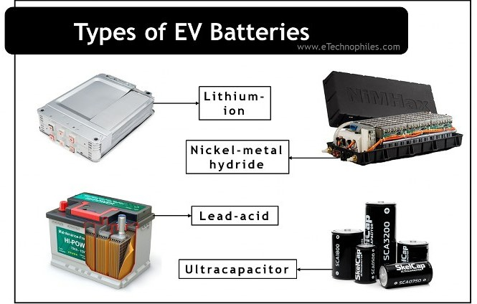
Types of Energy Storage Systems
Lithium-Ion Batteries: because of their high energy per unit mass relative to other electrical energy storage systems. They also have a high power-to-weight ratio, high energy efficiency, good high-temperature performance, and low self-discharge.
Nickel-Metal Hydride Batteries: These batteries have been widely used in HEVs. The main challenges with nickel-metal hydride batteries are their high cost, high self-discharge and heat generation at high temperatures, and the need to control hydrogen loss.
Lead-Acid Batteries: low specific energy, poor cold-temperature performance, and short calendar and lifecycle impede their use. Advanced high-power lead-acid batteries are being developed, but these batteries are only used in commercially available electric-drive vehicles for ancillary loads.
Ultracapacitors: They have a much lower energy density than batteries, meaning they are not as efficient at storing energy over long periods of time, They are more expensive than batteries

Slide 17
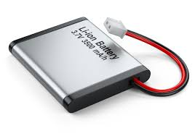
Li-ion BATTERY AND ITS SPECIFICATIONS:
Nominal voltage (V): 360
Rated capacity (Ah): 100

Slide 18
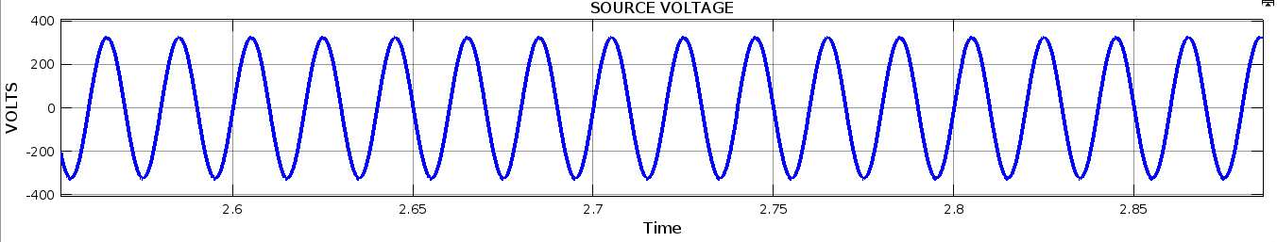
SOURCE VOLTAGE

Slide 19
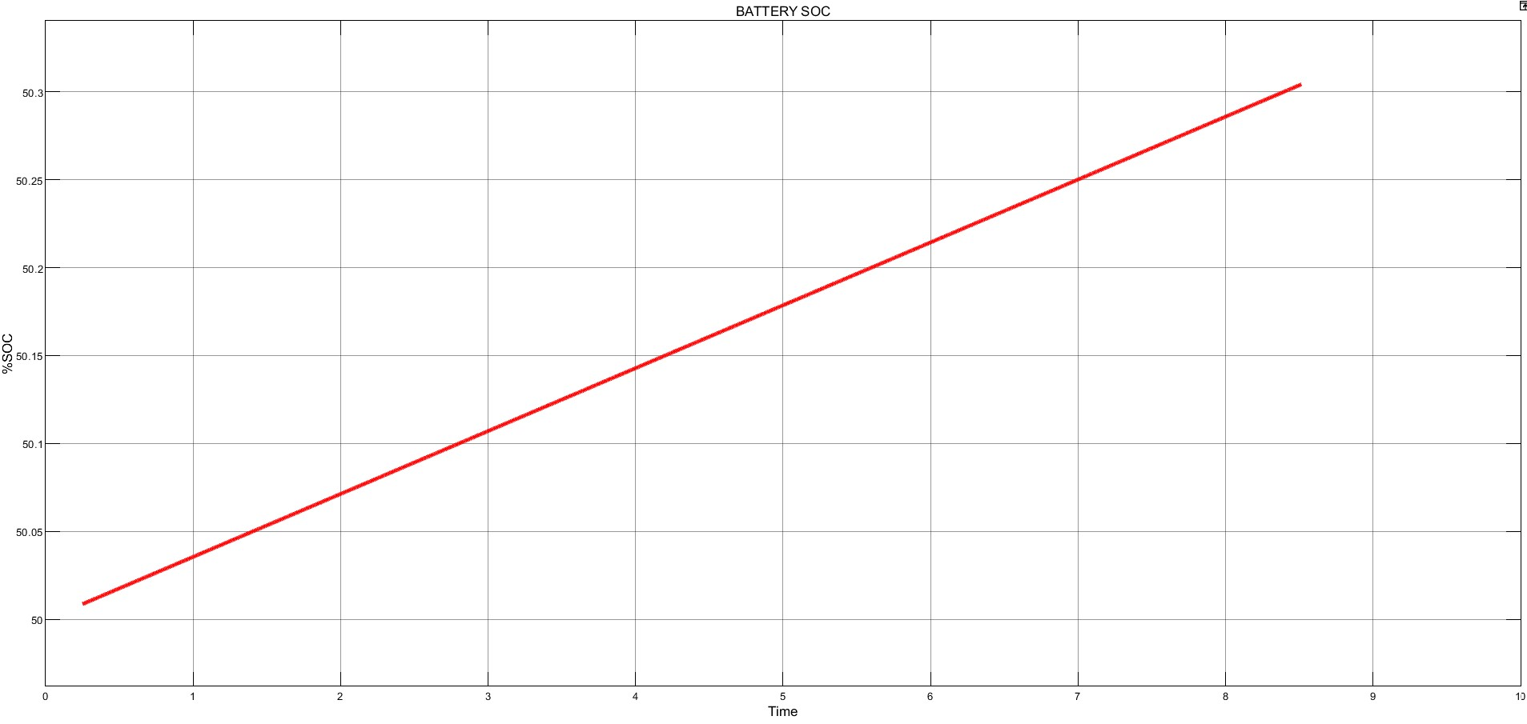
STATE OF CHARGING

Slide 20
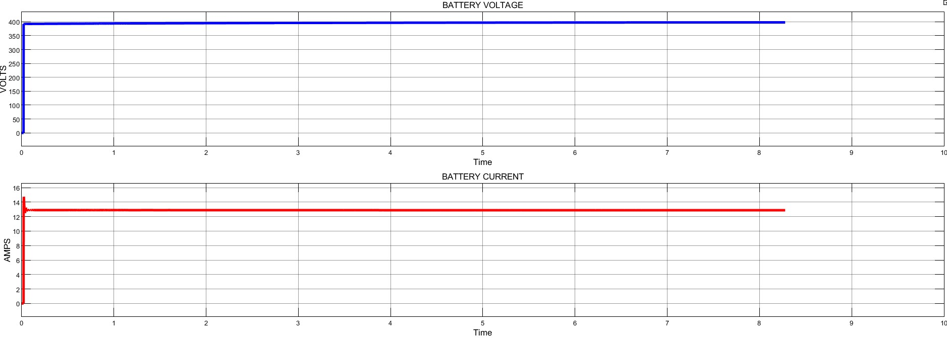
BATTERY VOLTAGE AND BATTERY CURENT

Slide 21
THANK YOU

